Slide 1
French Revolution
Element: Identify the causes and results of the revolutions in England (1689), United States (1776), France (1789), Haiti (1791), and Latin America (1808-1825)
Vocabulary: French Revolution

Slide 2
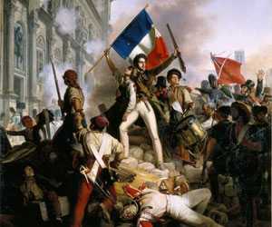

Slide 3
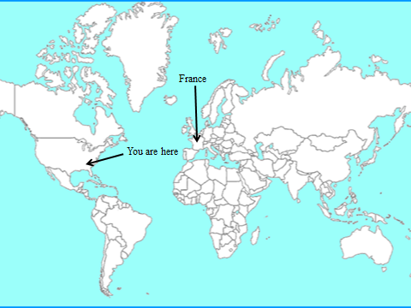
France
You are here

Slide 4
A Tale of Two Cities
“It was the best of times, it was the worst of times, it was the age of wisdom, it was the age of foolishness, it was the epoch of belief, it was the epoch of incredulity, it was the season of light, it was the season of darkness, it was the spring of hope, it was the winter of despair, we had everything before us, we had nothing before us, we were all going direct to heaven, we were all going direct the other way .”
Charles Dickens

Slide 5
French Revolution
Description:
marked the end of Europe’s old order of a world dominated by rich aristocrats
the beginning of a new order valuing equality, representative government, individual rights, and nationalism
occurred over the course of a decade and came in a number of stages

Slide 6
The Old Regime
Old Regime:
social/political system in France during the 1770s placing people into 3 social classes.
Estates:
three social classes of France’s Old Regime

Slide 7
The Privileged Few
First Estate:
Catholic clergy (bishops, priests, etc.)
1% of population
owned 10% land
paid few taxes
Second Estate:
rich nobles (aristocrats)
2% population
owned 20% land
paid no taxes
occupied many of the nation’s positions of leadership and influence

Slide 8
The Third Estate
made up of peasants, urban workers, middle class (bourgeoisie)
97% of population
paid heavy taxes
had no voice in government
were eager for change

Slide 9
The Bourgeoisie
consisted of bankers, merchants, lawyers, etc.
many members of the bourgeoisie supported the political ideas of the Enlightenment
wanted to reform the French monarchy along with many of the nobility

Slide 10
Review…
What was the name of the social/political system in France that divided people into three social classes?
Which estate had no voice in government, but paid almost all the taxes?

Slide 11
National Assembly
Causes:
late 1780s
inspired by Rousseau and American Revolution
economic hardship, food shortages, discontent over the nation’s tax system and land policies
the near financial collapse of the government

Slide 12
Estates General
King Louis XVI and his wife Marie Antoinette lived extravagantly
debt doubled
banks refused to lend more money
forced King Louis XVI to call an assembly of France’s legislative body in 1789
it had not met for over 150 years
each estate was represented

Slide 13
King Louis XVI and Marie Antoinette

Slide 14
Review…
What philosophe and revolution encouraged the French people to seek change?
While Louis and Marie lived the life of luxury, what type of problems was the 3rd Estate facing?
Why did the 3rd Estate believe that the Medieval rules of the Estates General were unfair?

Slide 15
National Assembly
Actions:
members of the Third Estate quickly seized control and called themselves the National Assembly
“Tennis Court Oath”
drew up a new constitution
the king threatened to use force to put down the new assembly

Slide 17
Storming the Bastille
after rumors that Louis XVI would use the military against the National Assembly
an angry mob stormed a prison and armory known as the Bastille
the mob cut off the head of the garrison leader defending the fortress and marched it through the streets of Paris
peasant uprisings filled the French countryside
women peasants took Louis and Mary Antoinette from Versailles to Paris

Slide 18
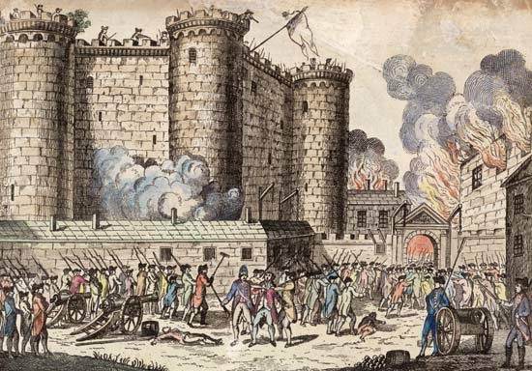

Slide 19
Review…
What was the National Assembly’s primary goal?
Explain the Tennis Court Oath.
Why did peasants storm the Bastille?

Slide 20
The Assembly Reforms France
wrote The Declaration of the Rights of Man - all men are born free and entitled to equal rights
took Church lands and made clergy elected officials
offended many peasants

Slide 21
Escape Attempt
in 1791
royal family attempted to escape to Austria
were captured and sent back to Paris

Slide 22
Constitutional Monarchy
the Constitution of 1791 replaced the old order of French government with a limited monarchy
took most of the power away from the king
Legislative Assembly now had power in France

Slide 23
Review…
What French document stated that men are born free and are entitled to equal rights?
What action did the National Assembly take that offended many peasants?
After Louis had limits put on his power, what group gained control of France?

Slide 24
Revolution Divisions
Émigrés: nobles who had fled France; hoped to end the revolution and restore Old Regime
Sans-culottes: workers who wanted radical changes

Slide 25
Reaction by European Nations
other European nations grew alarmed
foreign kings feared that the revolutionary spirit might spread to their countries
France found itself at war with many of its European neighbors

Slide 26
France at War
Summer of 1792
Austria and Prussia urged France to restore King’s power
France declared war
Prussian officer threatened to destroy Paris

Slide 27
Cause for another Government Change
early military defeats and continued economic hardships led to another change in government
a radical mob stormed the royal palace
took the king captive
forced the assembly to suspend the French monarchy

Slide 28
Review
Why did other European countries wish to restore the king’s power?
What is the difference between an Émigré and a Sans-Culotte?
Why did the French people imprison Louis and his family?

Slide 29
The New National Convention
took charge
abolished the monarchy
executed the king of France January 21, 1793

Slide 30
Committee of Public Safety
many Frenchmen felt that such actions were too drastic and refused to support the National Convention
other European nations were appalled by the king’s execution and prepared to invade France
the National Convention empowered a group called the Committee of Public Safety to deal with the crisis

Slide 31
Reign of Terror
Jacobins:
a party of radicals
under the leadership of Maximilien Robespierre
took control of the Committee of Public Safety

Slide 32
Foreign Enemies
quickly raised an army of well over one million Frenchmen
pushed back France’s foreign enemies
contributed to the rise of nationalism (pride in one’s country)

Slide 33
Enemies inside France
launched a period known as the Reign of Terror
the state executed thousands of French citizens on the guillotine (contraption that cut off people’s heads)
ended when a rival group seized control of the National Convention
executed Robespierre in July, 1794

Slide 34
Review...
What radical group supported a republican type of government, and had the king executed?
Who was targeted during the Reign of Terror?
Why did the National Convention turn on Robespierre?

Slide 35
The Directory
Description:
a new constitution passed power to five directors in 1795
known as the Directory
the period was riddled with corruption and political rivalries between royalists who wanted to return the monarchy and radicals still enraged by ongoing economic problems
looked to the army to maintain its position of power

Slide 36
Dictator in France
in 1799 one of the army’s most popular generals, Napoleon Bonaparte took advantage of the political situation to seize power
eventually declared himself emperor of France

